Slide 1
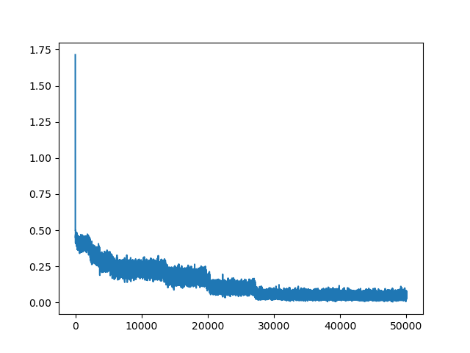
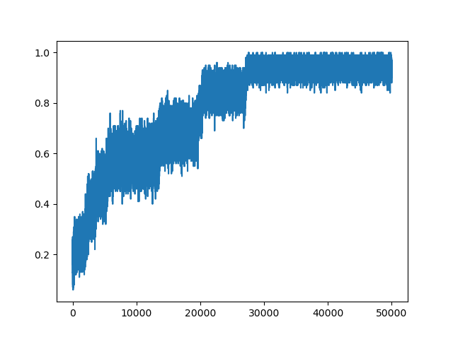
L=2
alpha = 0.05
max_epoch = 500
layer_size = [ 784
10 ]
Your figure here
Your figure here

Slide 2
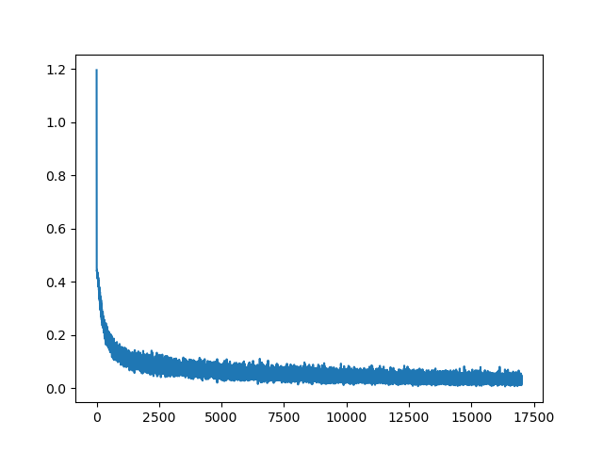
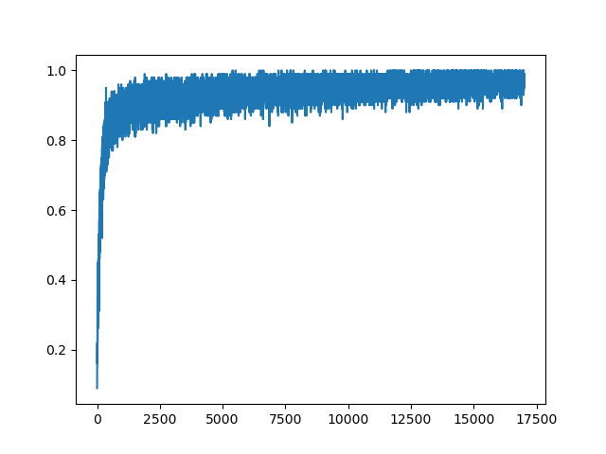
L=3
alpha = 0.004
max_epoch = 170
layer_size = [ 784
128
10 ]
Your figure here
Your figure here

Slide 3
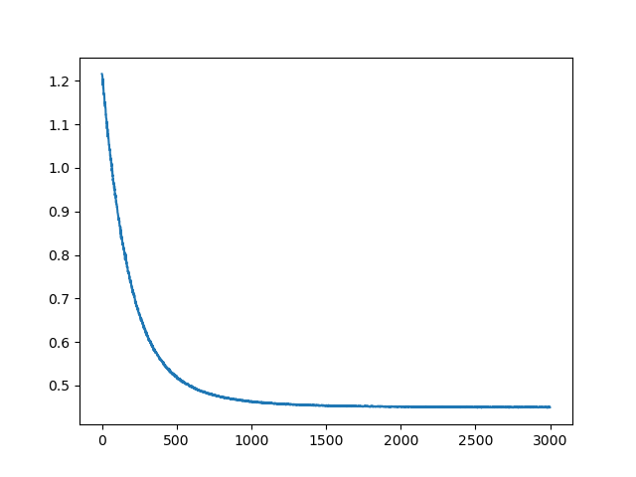
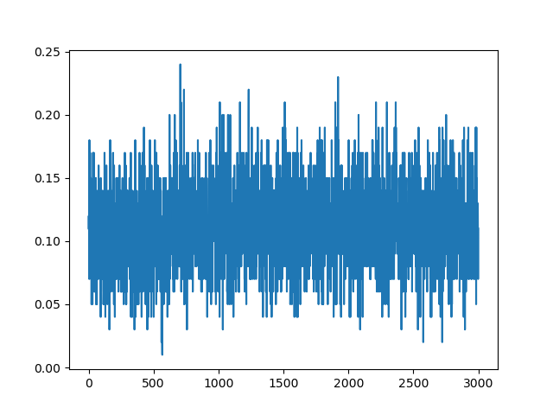
L=8
alpha = 0.001
max_epoch = 30
layer_size = [ 784
512
256
128
64
32
16
10 ]
Your figure here
Your figure here

